Slide 1
Induction Game (IG)
Shahrukh Mohiuddin

Slide 2
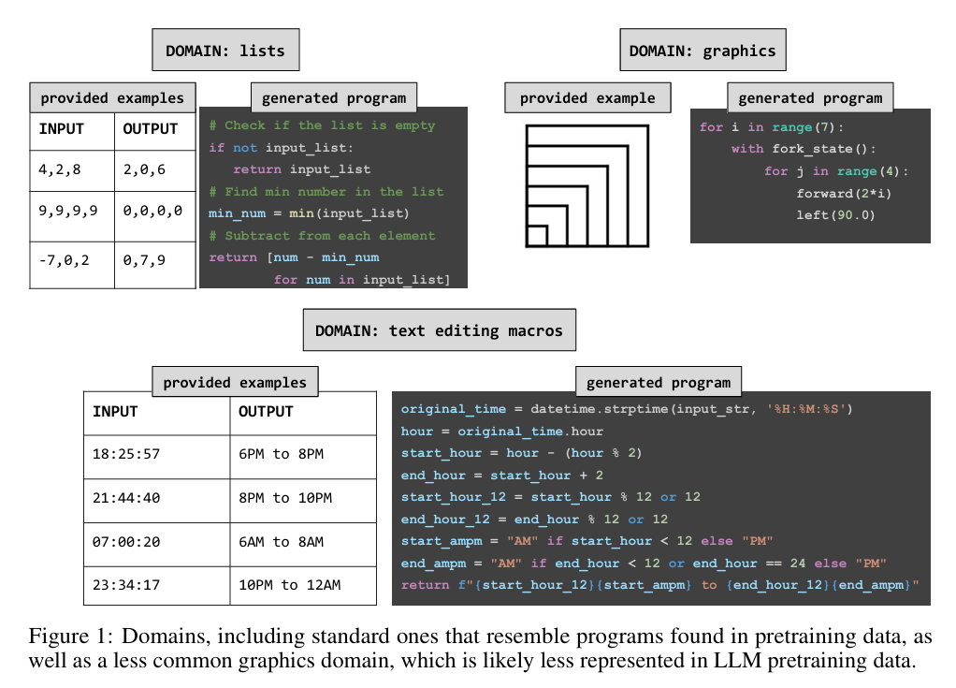
What does induction mean in this context?
The process of generating an abstract idea / program based on some concrete evidence (I/O pairs).
Is there proof that this method works?
Is Programming by Example Solved by LLMs?
CodeARC: Benchmarking Reasoning Capabilities of LLM Agents for Inductive Program Synthesis

Slide 3
Findings of the papers?
Pretrained and Instruction tuned LLM’s are not good at induction / Programming by Examples.
Fine tuning improves their performance significantly.
My interest in reading these papers
LLM’s can do induction.
Planning and making a roadmap.
See some relevant material to programming with induction.

Slide 4
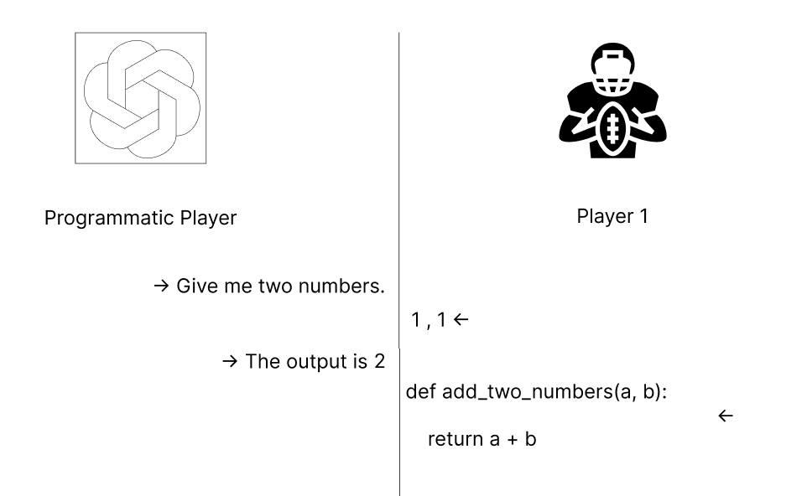
Induction Game Concept
We are interested in the output of the function “Guessed” by player 1.

Slide 5
What would be require?
I/O Samples
The correct program
Test cases to test the player 1’s program

Slide 6
What I have seen so far…
Dataset Name | Focus | Key Features
CodeARC | General-Purpose Python Induction | dataset of 1114 diverse Python functions with initial I/O examples.
DSCodeBench | Data Science Code Generation | has Ground Truth Code and an automatically generated Test Case Script for producing tailored input-output examples.
Program Synthesis Benchmark Suite (PSB) | Standard Algorithmic Problems | Provides canonical datasets (PSB1 and PSB2) for general programming tasks (e.g., fizz-buzz, gcd) with over 1 million labeled cases per problem
Case2Code | Scalable Synthetic Data | Given a function, generates a pair of inputs and outputs for this function. Good if I want to generate large sets of I/O pairs.

Slide 7
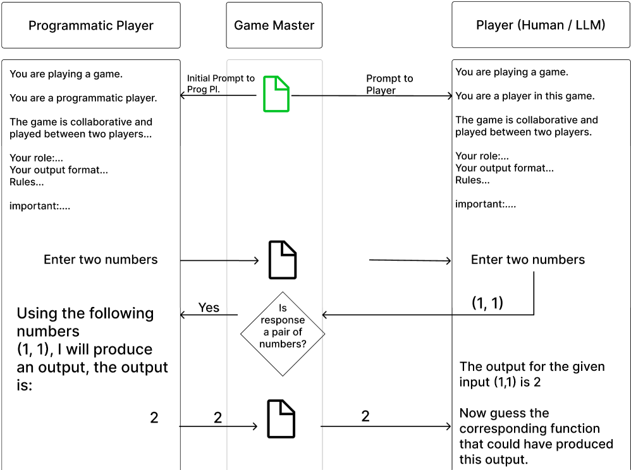
Game Diagram

Slide 8
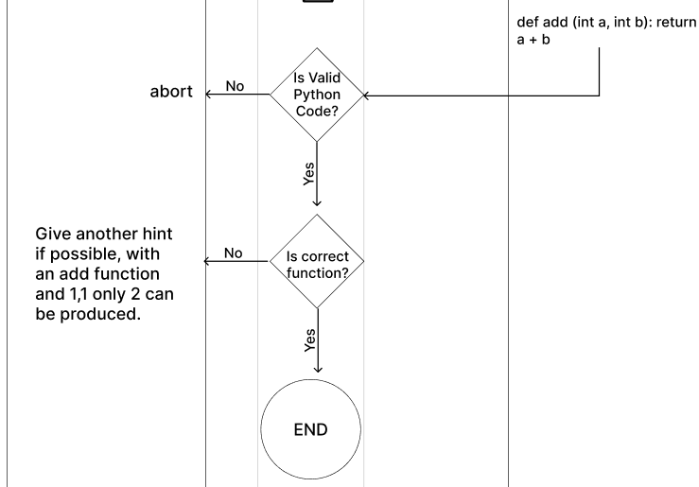
Game Diagram cont.

Slide 9
Timeline:
“If I had 8 hours to chop down a tree, I would spend 6 sharpening my knife”
Phase | Estimated Duration | Deliverables Date (DD.MM.YY) | Key Activities
Groundwork & Core Logic | 1–2 Weeks | 02.12.25 | Reading papers, additional groundwork, and implementing basic game logic and player interactions.
Prompt Engineering | 1 Week | 09.12.25 | Designing, testing, and refining the LLM prompt templates for the Induction Player.
Instances & Experiments | 1 Week | 16.12.25 | Finalizing game instances (function set) and experiment parameters for initial runs.
Evaluation Metrics | 1–2 Weeks | 30.12.25 | Identifying and implementing evaluation metrics (e.g., accuracy, queries needed).
Final Polishing | 2–3 Weeks | 20.01.25 | Polishing and finalizing the game setup. + Documentation.

Slide 10
Related Work
CodeARC: Benchmarking Reasoning Capabilities of LLM Agents for Inductive Program Synthesis
Is Your Code Generated by ChatGPT Really Correct?
Case2Code Dataset link
Case2Code: Scalable Synthetic Data for Code Generation

Slide 11
Questions
Are the functions kept as JSON?
How many functions should there be?
How can this morph into medical stuff?

